Slide 1

Nursing, Midwifery and Allied Health Professionals (NMAHP) Development Framework
Managers Workshop

Slide 2

Workshop hosts:
Catrin Evans
Principal Educator, NHS Education for Scotland, NMAHP Directorate.
Iain Christie
Senior Radiographer, NHS Lothian.

Slide 3
Learning outcomes
Following the workshop, you will be able to:
Explain the Framework and its key benefits for managers.
Define the key components of the Framework and how it supports staff development and performance improvement.
Identify available resources and support materials for Framework implementation.
Apply practical strategies to overcome barriers and enhance the use of the Framework.

Slide 4

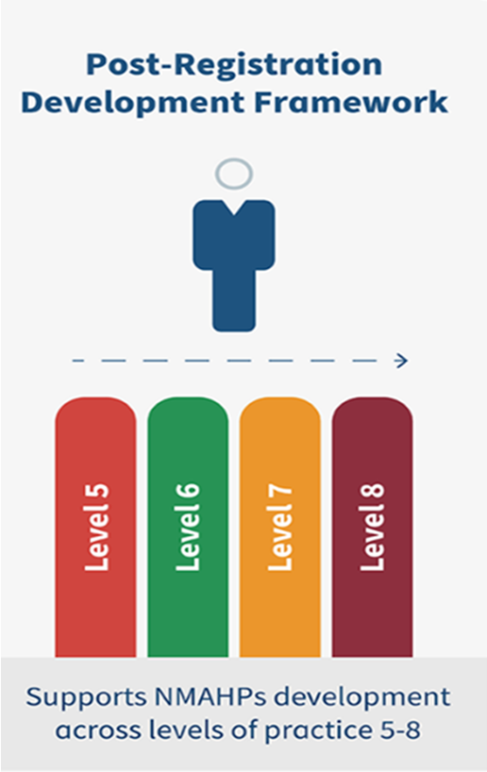
NMAHP Development Framework

Slide 5

Why do we have the NMAHP Development Framework?
Primary purpose is supporting professional growth
Generic framework for all NMAHPs
Ensuring safe and effective care
Alignment with Healthcare policy and priorities
Workforce development and sustainability
Enhancing career progression and job satisfaction
Fostering leadership and innovation
Support wellbeing and retention
Regulatory and Professional Standards

Slide 6

Purpose of the NMAHP Development Framework?
For individuals, managers and educators
Generic standard for all NMAHP practice
Structured professional development
Supports career progression
Underpins appraisal and personal development planning
Supports wellbeing

Slide 7

Participant Poll
Q1. Do you use the NMAHP Development Framework?
Q2. What do you see as the barriers to using the NMAHP Development Framework?

Slide 8

Using the framework managers perspective
A manager can use the framework to support:
  Professional development discussions
  Appraisal process
  Supervision
  Performance management
  Standards of practice
  Workforce planning
  Recruitment and retention
  Workforce planning
  Team wellbeing

Slide 9

Manager Survey Key Findings
Benefits of using the framework:
Standardisation
Integration
Signpost staff to learning resources/career pathways
Challenges:
Time
Awareness/misunderstandings amongst staff
Perceived complexity
Buy in from their teams

Slide 10

What would help?
Workshops
Simplified explanation
Case studies
Exemplars
How it's all connected
How it’s used with other frameworks
Resources to assist managers
Endorsement from senior leadership
Adoption by team

Slide 11

Sharing user experiences
Dr Heather Cameron
Using the Framework

Slide 12


Slide 13
Key Elements of the Framework
Pillars
KSB statements
Levels
Self-assessment tools

Slide 14
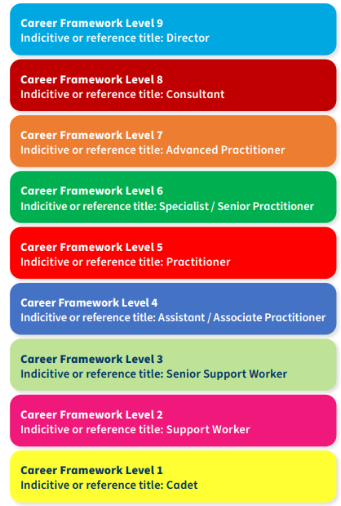
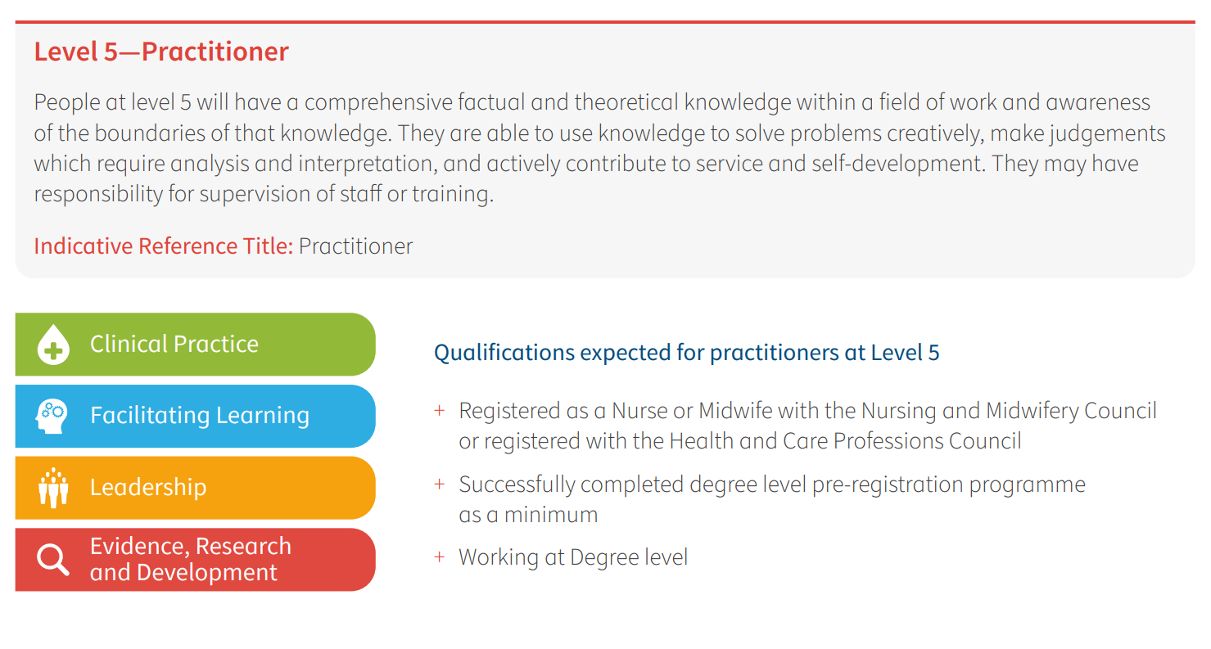
Levels of practice
Career Framework for Health V2 (Skills for Health 2020)

Slide 15

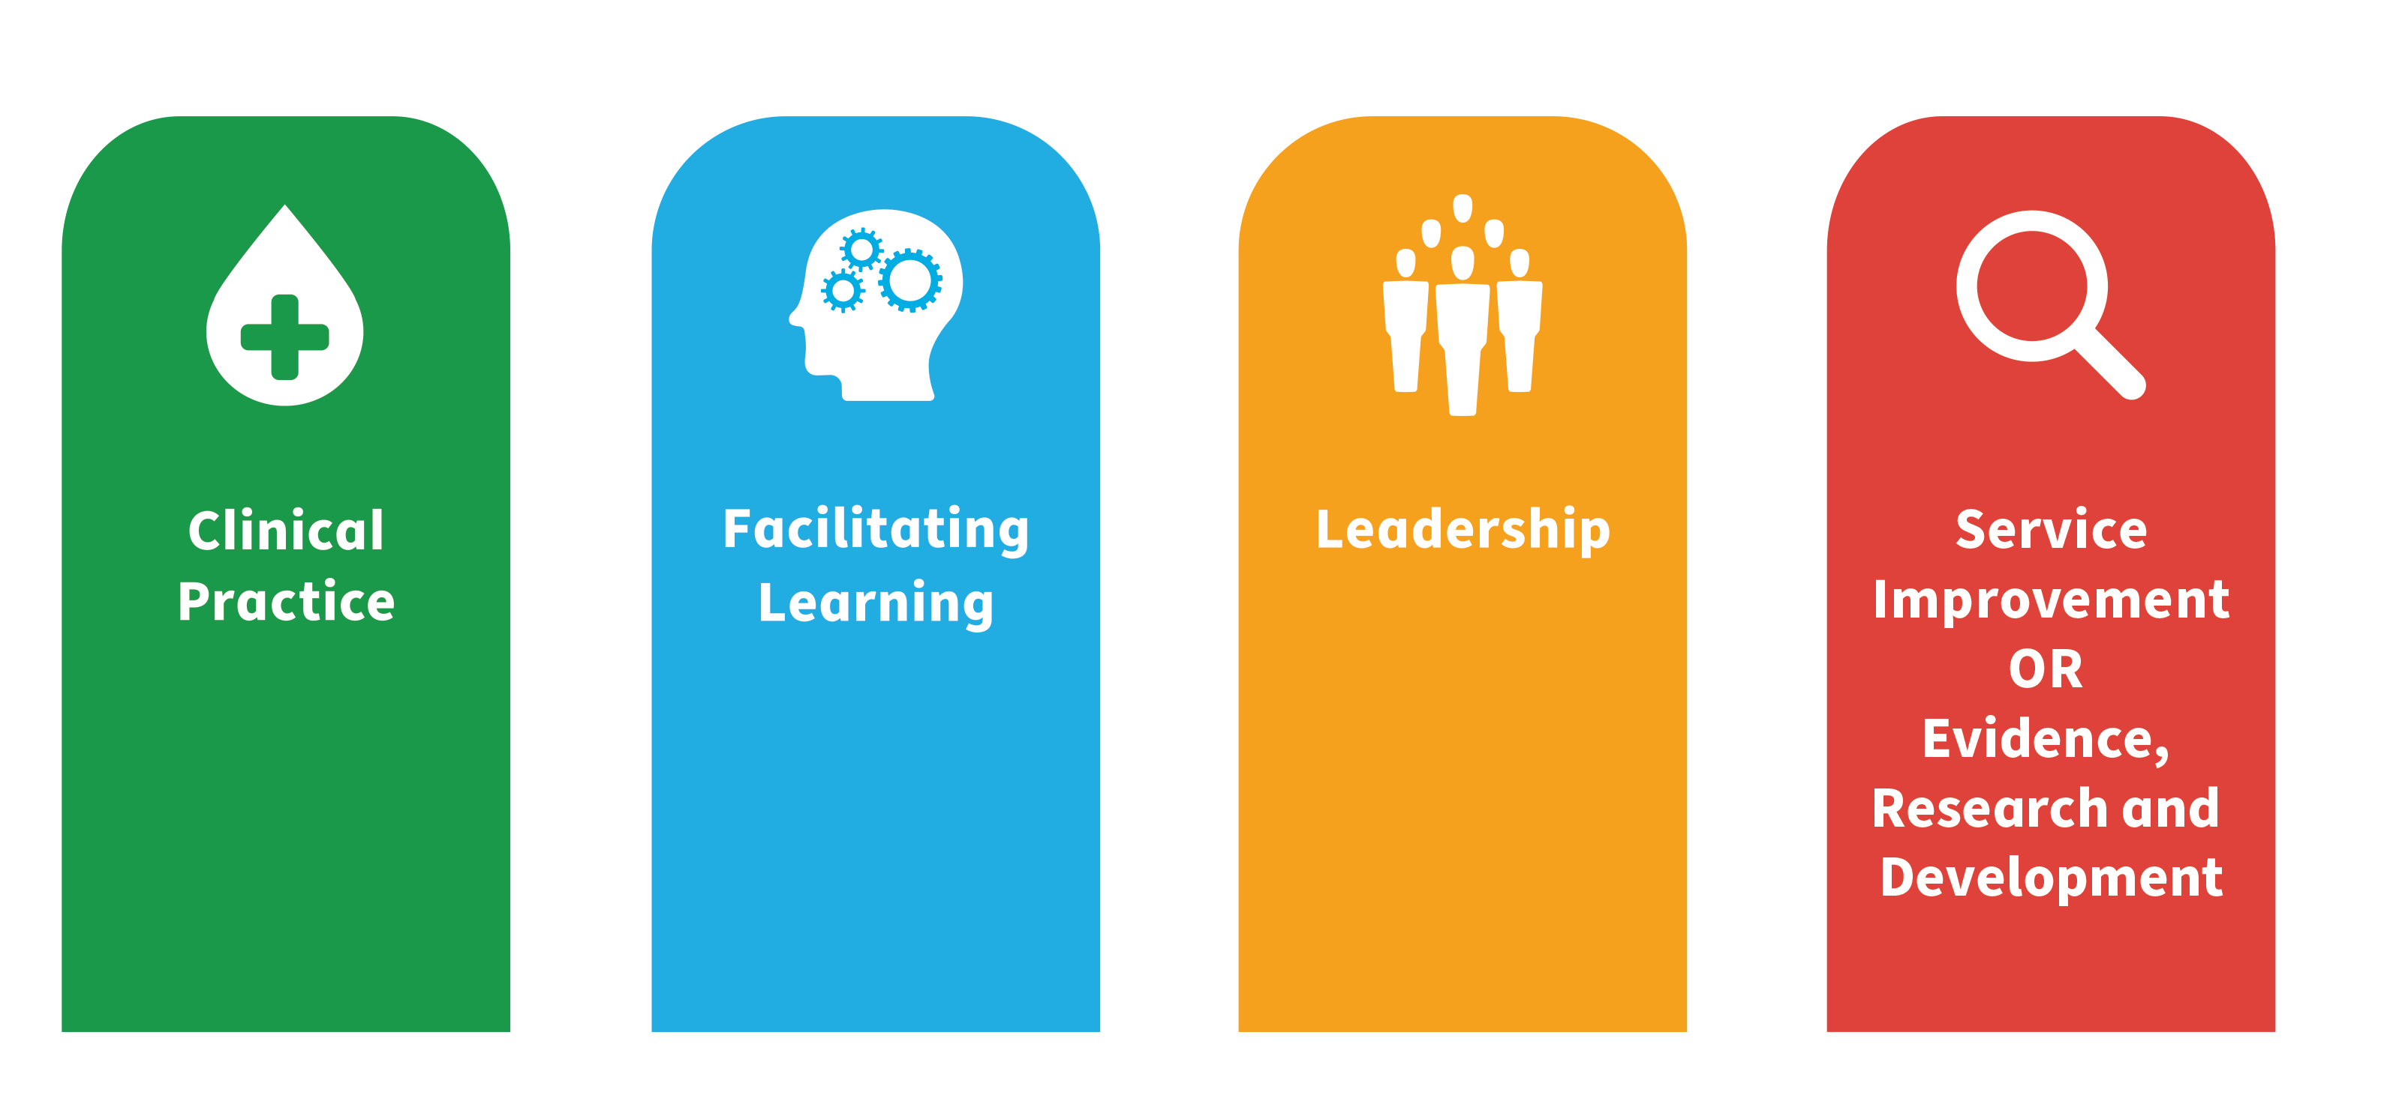
Pillars of practice

Slide 16
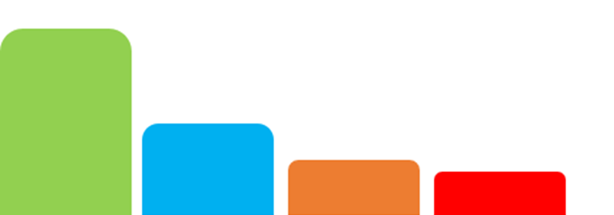
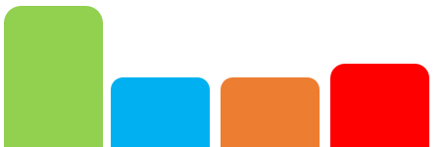












Using the pillars and the levels of practice
Level 3 Senior Healthcare Support Worker
Level 2 Healthcare Support Worker

Slide 17

Knowledge, skills and behaviours (KSBs)
KSBs are:
Central element of the framework designed to enable professional development.
Common to all NMAHP professions and specialities.
Knowledge statements describe core information, theories and concepts.
Skills statements describe practical skills and abilities.
Behaviour statements describe the attitudes and professional conduct.
KSBs provide a comprehensive guide at every career stage.

Slide 18

NMAHP Development Framework tools and resources
Development Needs Analysis Tool (DNAT) online and word versions
Framework Reflective Self-assessment Tool
Action Planning and Priority Rating Tool
Level specific Professional Development Resources

Slide 19
Development Needs Analysis Tool (DNAT)
The DNAT is designed to help practitioners reflect on their current job role and to identify areas for further training, education and development.
Main features:
Versions online/offline
Self-assessment using Red Amber Green (RAG) rating scale
Personalised development planning
Continuous professional development (CPD)
Encourages ownership and accountability
Facilitates discussion
Track progress

Slide 20

Framework Reflective Self-assessment
The reflective tool is designed to help practitioners reflect on their current job role and to identify areas for further training, education and development.
Main features:
Word document
Self-assessment using RAG rating scale
Personalised development planning
CPD
Encourages ownership and accountability
Facilitates discussion
Track progress

Slide 21


Development Needs Analysis Tool Process
Select a Pillar
Self-assessment using Red Amber Green (RAG) rating
Evidence
Discussion and sign off

Slide 22
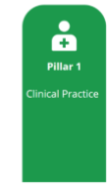
DNAT example
Knowledge, Skills and Behaviour statement
5C3 – Promote and deliver safe, effective and person-centred care as part of the multi-disciplinary team.
RAG rating
Green - I am already confident in carrying out this outcome competently
Evidence to support achievement
Case study and examples of care delivery. Quality improvement project report

Slide 23
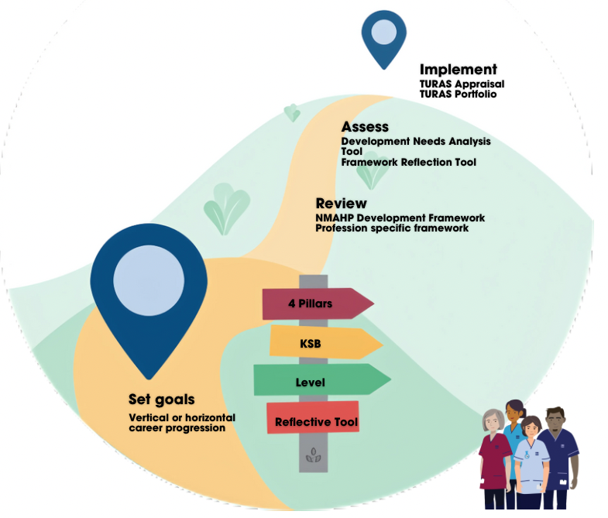
Framework Roadmap

Slide 24

Using Professional frameworks with NMAHP Development Framework​
NMAHP Development Framework is generic with core KSBs provided for all NMAHP staff
Tips
Review both frameworks with a specific goal in mind
Identify KSBs from your profession specific framework
Align similar areas in both frameworks
Look for overlap and gaps
Identify priority areas
Have a mix of profession specific and generic goals
Notes:
IC We've talked about the process for using the NMAHP Dvelopment Framework so how do you How to use it with the Profession Specific Framework
The NMAHP Development Framework delivers the generic KSBs, which underlines everyone's role and is non profession specific. This enables a common language between all professions, develops cohesion amongst the diverse healthcare professionals under the NMAHP umbrella, facilitates multi disciplinary approaches to healthcare and enables diversity in career pathways.
The profession specific frameworks, as their name implies, provide those KSB's which are specific to our individual profession.
To use both together.
Familiarise yourself with both frameworks, having a specific goal in mind eg do you want to be an advanced practioner within your profession.
What is the 4 pillar mix for your role and target role eg is leadership more prominent or research
Identify KSB's in the 4 pillars in both frameworks that are relevant to your current role and to what you want to acheive
Profession specific KSB's tend be mainly in the research and clinical pillar, whilst leadership and Facilitating Learning KSBS are more in the generic NMAHP Development Framework.
Identify areas of overlap and divergence.
Create a matrix to align similar areas in both frameworks
Identify gaps - note NMAHP elements not covered in profession specific framework and vice versa
Prioritise - address high impact areas first
Finally set integrated goals pair a profession specfic goal eg mastering wound care with an NMAHP goal (eg leading a team discussion on best practice for woundcare)
I hope that helps, what I would say is familiarise yourself with both the NMAHP and profession specific frameworks to get the most out of them

Slide 25
Using the DNAT
Eilaine White
Using the DNAT

Slide 26


Slide 27
HCSW development
David McLaughlin
HCSW development

Slide 28


Slide 29

Benefits of the Framework
Versatile and flexible.
Facilitates a standardised approach to appraisal, staff development and the creation of learning plans.
Brings together NMAHP roles.
Aligns with PDP and learning plan resources on TURAS.
Signposts staff to resources.

Slide 30

Barriers to utilisation of the NMAHP Development Framework
Lack of time
Utilisation of the framework can save time by directing learning and development
One hour per pillar
Awareness
We are addressing this
Help us – talk to your team
Perceived complexity
4 simple steps
Relevance (not another form)
Framework is the foundation which describes our roles

Slide 31

Top Tips
Lead by example
Understand the pillars of practice
Speak to colleagues and get peer support
Have clearly defined goals
Break it down one pillar at a time
Use reflective practice to assess how well the framework is being applied

Slide 32

Next steps and call to action
Implementation
Help and support available
Use the framework to support own development - role model
Use with teams
Sign up team for our user workshops
Spread the word –availability 19th March workshop

Slide 33

Participant Poll
Q1. Are you now going to use the framework
Q2. What activity are you most likely to use the framework for?

Slide 34

Frequently Asked Questions (FAQs)
Please post on the chat if you have any questions
Contact the team at postreg.nmahp@nes.scot.nhs.uk

Slide 35

Workshop close
Thanks for listening
Evaluation form
Website launch event 29th April 3 – 4pm
User workshops
May 20th at 3 – 4.30pm
May 28th at 2 – 3.30pm
June 5th at 1 – 2.30pm

Slide 36
End slide

